Slide 1
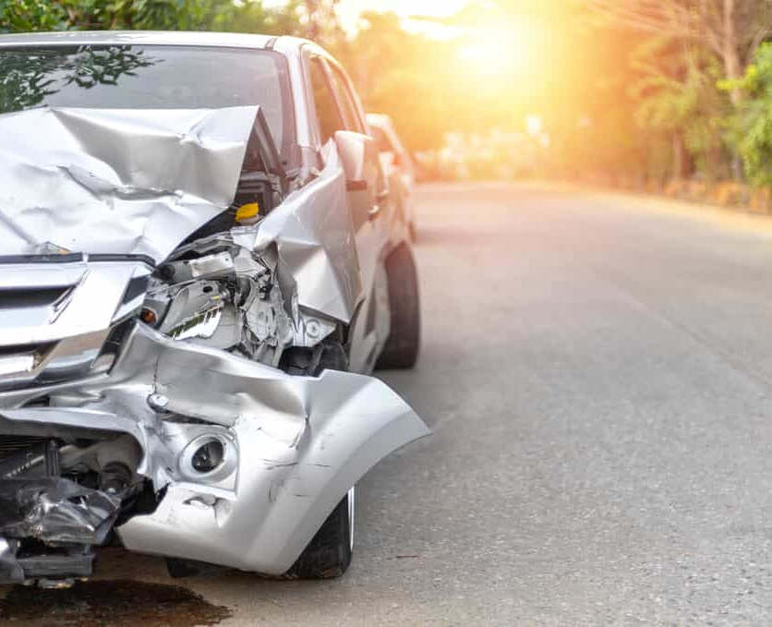
FATALITY ANALYSIS REPORTING SYSTEMS(FARS)
Guide by: Prof. Roy Wada
Prepared by: Vartika Joshi
Sayali Kolte
Qiaojia Liu

Slide 2
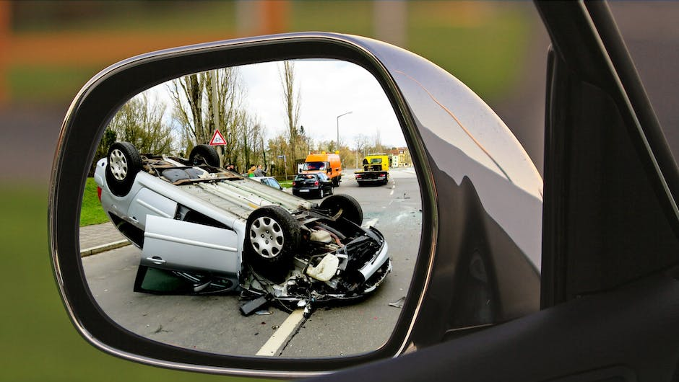
INTRODUCTION
The objective of this project is to analyze a traffic accident dataset and uncover insights into the causes and factors that contribute to accidents.
The project used data from the US National Highway Traffic Safety Administration's Fatality Analysis Reporting System (NHTSA-FARS) to examine the relationships between various demographic, behavioral, and environmental factors and the likelihood of a fatal traffic accident occurring.
Two methods were used in this analysis: descriptive statistics and regression analysis.
Notes:
Briefly explain the purpose of the presentation, which is to analyze the Fatality Analysis Reporting Systems (FARS) data set.
Mention that this data set contains information on fatal motor vehicle accidents in each of the 50 states, with 185426 observations and 56 variables.

Slide 3

DATA OVERVIEW
The data includes information on the location of the accident, the number of vehicles involved, the number of fatalities, and the conditions of the accident (weather, road, etc.)
The data also includes information about the drivers involved in the accidents, such as age, gender, and alcohol or drug involvement
The data contains information about the year, month, and day of the accidents, as well as the hour and minute of the accident
Information is also provided on whether the driver had a valid or invalid license and whether they were involved in speeding or other moving violations.
There are 182k rows in the data set .
Notes:
Provide a brief overview of the data set, including the number of observations and variables.
Mention the types of data included in the data set, such as quantitative types of data.
Highlight the main questions you will be answering in your analysis.

Slide 4






DATA CLEANING AND PREPARATION
Data Acquisition
Data Inspection
Data Cleaning
Data Transformation
Data Normalization
Notes:
Discuss the steps you took to clean and prepare the data for analysis.
Explain any missing values, outliers, and other data issues that you addressed.
Mention any data transformations or feature engineering you performed.

Slide 5

EXPLORATORY DATA ANALYSIS
There are 1,85,426 observations and 56 variables
Data set contains qualitative type of data
Ordinal Data - "day_week" column represents the day of the week and could be considered ordinal, as each day is given a numerical value, where Monday is represented as 1, Tuesday as 2, and so on.
Nominal data – e.g. "drunk_dr"
Notes:
Present visualizations and statistics to help you understand the distribution of the data and relationships between variables.
Use plots such as histograms, scatter plots, and box plots to visualize the data.
Use measures such as mean, median, and standard deviation to describe the central tendency and spread of the data.

Slide 6
Table 1: Descriptive Statistics
​ | Mean​ | Median​ | SD​ | Variance​ | Skewness​ | Kurtosis​
state​ | 27.89​ | 28.00​ | 16.22​ | 263.22​ | -0.02​ | -1.35​
county​ | 91.47​ | 71.00​ | 95.37​ | 9096.33​ | 2.84​ | 11.73​
city​ | 1194.31​ | 0.00​ | 1890.68​ | 3574660 | 1.98​ | 4.06​
day​ | 15.65​ | 16.00​ | 8.84​ | 78.07​ | 0.02​ | -1.20​
month​ | 6.76​ | 7.00​ | 3.35​ | 11.21​ | -0.11​ | -1.13​
year​ | 2012.52​ | 2013.00​ | 1.72​ | 2.94​ | -0.01​ | -1.27​
day_week​ | 4.14​ | 4.00​ | 2.10​ | 4.43​ | -0.10​ | -1.35​
nhs​ | 0.33​ | 0.00​ | 0.47​ | 0.22​ | 0.71​ | -1.50​
weather​ | 2.57​ | 1.00​ | 3.28​ | 10.73​ | 1.76​ | 1.23​
fatals​ | 1.08​ | 1.00​ | 0.38​ | 0.14​ | 5.31​ | 62.08​
drunk_dr​ | 0.31​ | 0.00​ | 0.48​ | 0.23​ | 1.10​ | -0.05​
total_numoccs​ | 2.26​ | 2.00​ | 1.96​ | 3.85​ | 8.27​ | 224.00​
total_hit_run​ | 0.05​ | 0.00​ | 0.21​ | 0.05​ | 4.22​ | 15.81​
total_registered_owner​ | 0.82​ | 1.00​ | 0.76​ | 0.57​ | 2.67​ | 99.82​
total_fire_exp​ | 0.04​ | 0.00​ | 0.20​ | 0.04​ | 4.66​ | 19.69​
total_valid_license​ | 1.27​ | 1.00​ | 0.86​ | 0.74​ | 8.25​ | 547.66​
total_invalid_license​ | 0.17​ | 0.00​ | 0.40​ | 0.16​ | 2.06​ | 3.47​
no_prev_acc​ | 1.15​ | 1.00​ | 0.85​ | 0.72​ | 5.96​ | 348.68​
one_prev_acc​ | 0.15​ | 0.00​ | 0.37​ | 0.14​ | 2.64​ | 11.61​
two_prev_acc​ | 0.07​ | 0.00​ | 0.27​ | 0.08​ | 5.34​ | 66.76​
no_prev_sus​ | 1.23​ | 1.00​ | 0.85​ | 0.73​ | 7.42​ | 482.23​
one_prev_sus​ | 0.10​ | 0.00​ | 0.31​ | 0.10​ | 2.96​ | 8.49​
two_prev_sus​ | 0.13​ | 0.00​ | 0.36​ | 0.13​ | 2.85​ | 11.18​
no_prev_dwi​ | 1.39​ | 1.00​ | 0.82​ | 0.68​ | 10.43​ | 785.10​
one_prev_dwi​ | 0.03​ | 0.00​ | 0.18​ | 0.03​ | 5.19​ | 25.49​
no_prev_spd​ | 1.18​ | 1.00​ | 0.82​ | 0.67​ | 6.68​ | 431.57​
one_prev_spd​ | 0.18​ | 0.00​ | 0.41​ | 0.17​ | 2.24​ | 7.29​
dr_age_lower16​ | 0.00​ | 0.00​ | 0.07​ | 0.00​ | 15.16​ | 233.08​
dr_age_lower21​ | 0.10​ | 0.00​ | 0.31​ | 0.10​ | 2.93​ | 8.07​
dr_age_lower30​ | 0.31​ | 0.00​ | 0.51​ | 0.26​ | 1.56​ | 4.12​
dr_age_lower65​ | 0.80​ | 1.00​ | 0.80​ | 0.64​ | 5.36​ | 278.57​
dr_age_65over​ | 0.19​ | 0.00​ | 0.42​ | 0.18​ | 2.20​ | 6.44​
dr_male​ | 1.07​ | 1.00​ | 0.77​ | 0.60​ | 6.69​ | 408.80​
dr_female​ | 0.38​ | 0.00​ | 0.59​ | 0.34​ | 1.96​ | 18.25​

Slide 7
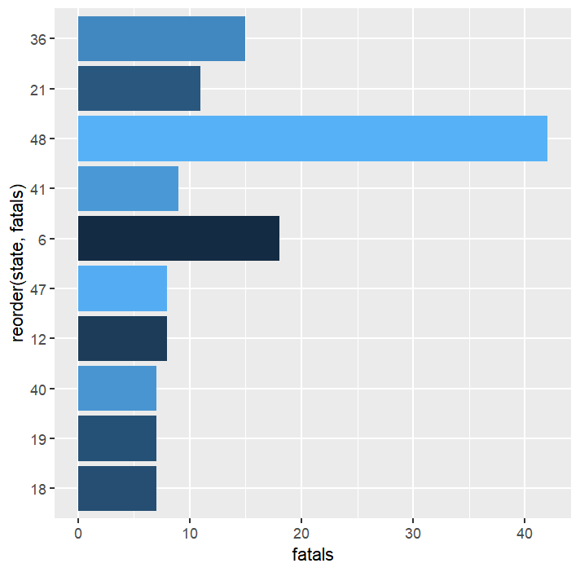
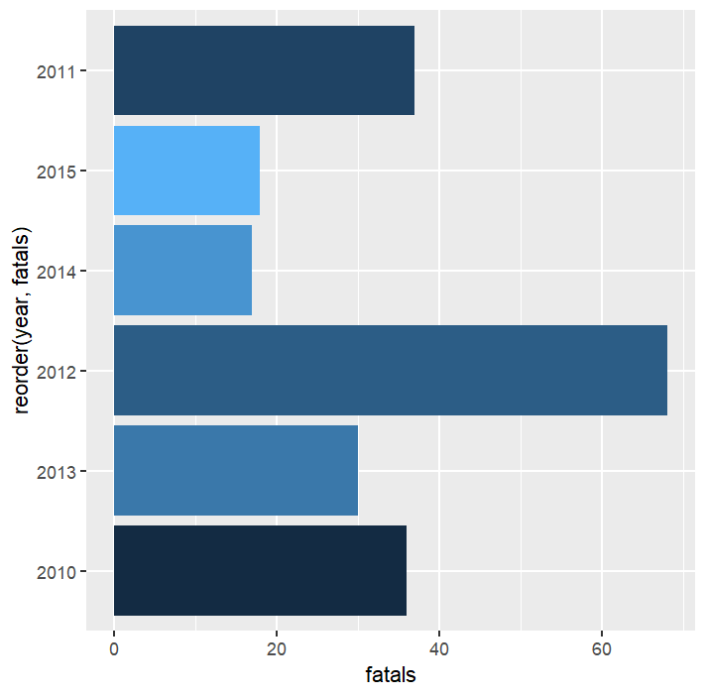
Visualization
Highest fatalities occuring states
Highest fatalities occuring year

Slide 8

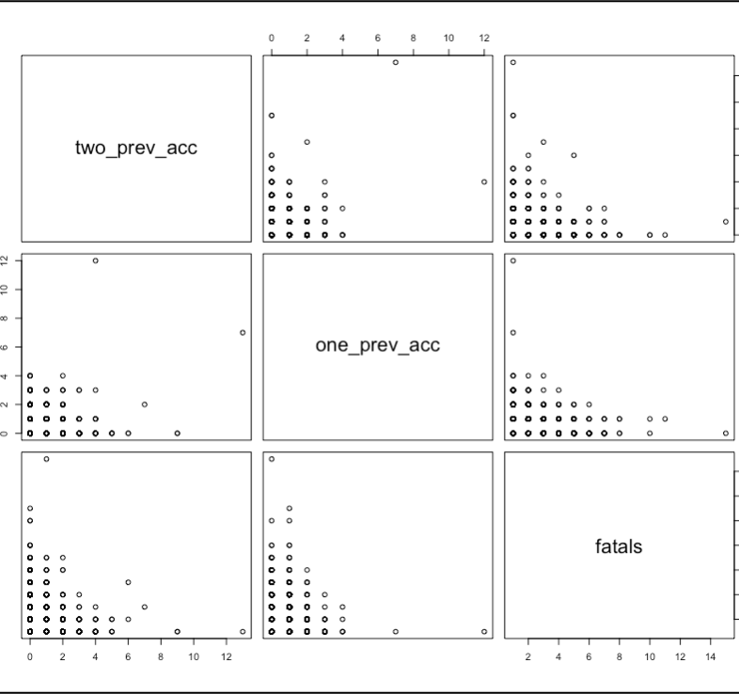
OBSERVATIONS
1.What factors contribute to the number of fatalities in car accidents?
ANOVA showed strong evidence (p<0.01) to reject the null hypothesis (H0) that there is no difference in the mean number of fatalities between different levels of drunk driving .
2. Is there a correlation between the number of previous accidents and the likelihood of a driver being involved in a fatal accident?
The results of both Pearson's correlation tests suggest that there is a positive correlation between the number of previous accidents and the likelihood of a driver being involved in a fatal accident.

Slide 9
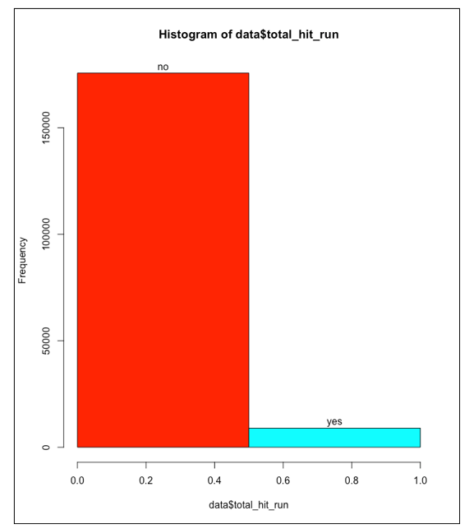
3.What is the frequency of hit-and-run accidents in the dataset?

Slide 10

MODEL DEVELOPMENT 1
Chi-square (χ²) is a statistical test used to determine the association between two categorical variables. It determines whether there is a significant difference between the expected and observed frequencies of categorical data.
Observation: What factors contribute to the number of fatalities in car accidents?
Notes:
Discuss the models you used to analyze the data, such as regression models, classification models, or clustering models.
Explain the reasons for choosing the specific models, such as the type of data and the research questions.
Present the results of the models, including the accuracy and the key findings.

Slide 11
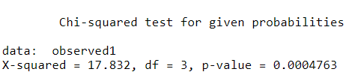
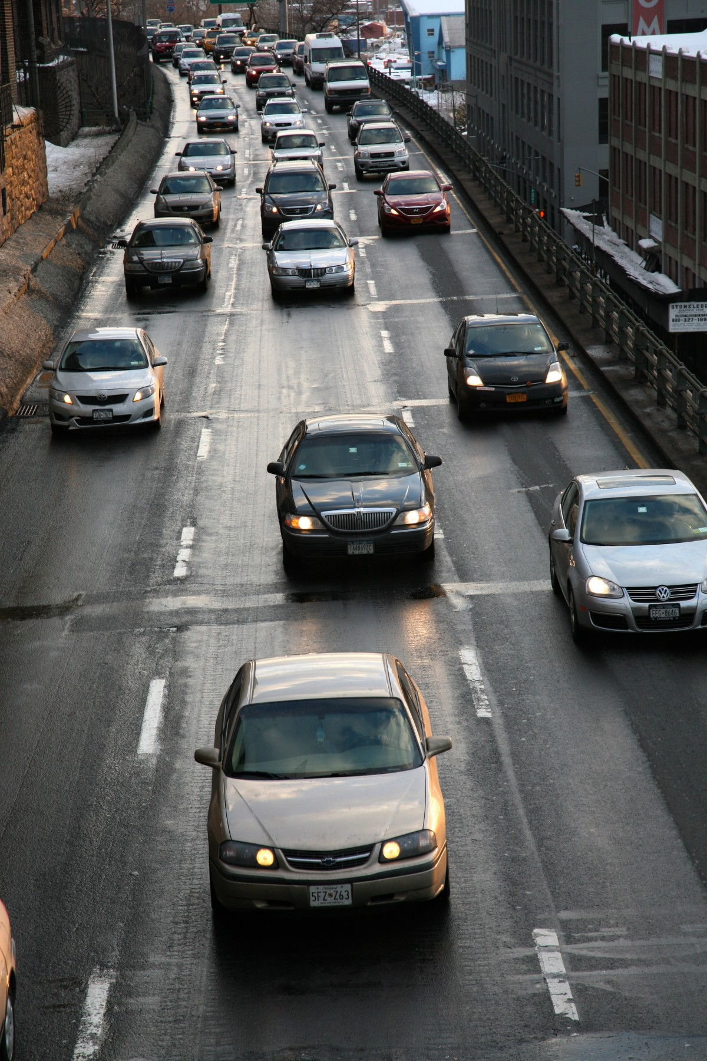
MODEL EVALUATION 1
Chi-square method:
X = st_case
Y= drunk_dr
Finding: At least one mean is different from the others.
Notes:
Discuss the evaluation metrics used to assess the performance of the models, such as R-squared, accuracy, F1 score, or AUC.
Explain the results of the model evaluation and the strengths and weaknesses of the models.
Provide suggestions for improving the models, such as adding or removing features, changing the model type, or fine-tuning the parameters.

Slide 12

MODEL DEVELOPMENT 2
Random Forest Regression is a type of ensemble machine learning method that uses a combination of decision trees to make predictions
Observation: Predict the number of fatals based on total hit-and-run, total registered owners, total not-registered owners, and total other owners.

Slide 13

MODEL EVALUATION 2
Model predicted the "fatals" (number of fatalities) using four predictor variables: "total_hit_run", "total_registered_owner", "total_not_registered", and "total_other_owner"
Model used to make predictions on testing data and converted to binary outcomes
Accuracy calculated by comparing predicted binary outcomes to actual fatals in testing data
The accuracy of the model was found to be 0.9421168, meaning that it has a high accuracy rate of 94.2% in making predictions.
Notes:
Discuss the evaluation metrics used to assess the performance of the models, such as R-squared, accuracy, F1 score, or AUC.
Explain the results of the model evaluation and the strengths and weaknesses of the models.
Provide suggestions for improving the models, such as adding or removing features, changing the model type, or fine-tuning the parameters.

Slide 14

CONCLUSION
Random Forest Regression analysis- The result of the accuracy calculation is 0.9421168, indicating that the model has a high accuracy in making predictions, with a 94.2% correct rate.
(ANOVA and Chi-square), There is no difference in the mean number of fatalities between different levels of drunk driving.
(correlation tests), There is a positive correlation between the number of previous accidents and the likelihood of a driver being involved in a fatal accident.
The histogram shows that Hit-and-runs are rare.
Notes:
Summarize the key findings from your analysis.
Mention the main contributions and limitations of your work.
Provide recommendations for future work based on your results.

Slide 15
REFERENCES
[1] ANOVA, regression, and Chi-square. Educational Research Basics by Del Siegle. (2015, June 14). Retrieved February 4, 2023, from https://researchbasics.education.uconn.edu/anova_regression_and_chi-square/
[2] Lasso regression model with R code: R-bloggers. R. (2021, May 19). Retrieved February 4, 2023, from https://www.r-bloggers.com/2021/05/lasso-regression-model-with-r-code/
[3] Correlation Test between two variables in R. STHDA. (n.d.). Retrieved February 4, 2023, from http://www.sthda.com/english/wiki/correlation-test-between-two-variables-in-r

Slide 16

THANK YOU

